Slide 1
Employee Data Analysis using Excel
STUDENT NAME:ANANDA VALLI.V
REGISTER NO:312214981
DEPARTMENT:COMMERCE (B.com)
COLLEGE: SOKA IKEDA COLLEGE OF ARSTS AND SCIENCE FOR WOMEN

Slide 2
PROJECT TITLE
Employee Performance Analysis using Excel

Slide 3


AGENDA
Problem Statement
Project Overview
End Users
Our Solution and Proposition
Dataset Description
Modelling Approach
Results and Discussion
Conclusion
3/21/2024 Annual Review

Slide 4

PROBLEM STATEMENT
Correlating Employee Attendance with Performance:
Problem Statement: "Is there a significant correlation between employee attendance and their performance ratings?"

Slide 5

PROJECT OVERVIEW
1. Review the Employee's Attendance Record:
Gather all relevant data about the employee’s attendance, including the number of absences, tardiness, and any patterns in behavior.
Compare the attendance record with company policies to determine if there are any violations
.

Slide 6

WHO ARE THE END USERS?
. 1. HR Manger
2.Project Manager

Slide 7

OUR SOLUTION AND ITS VALUE PROPOSITION
1.Assessment and Data Collection:
Gather Attendance Data: Collect data on employee attendance to identify patterns or recurring issues.
2. Link Attendance to Performance:
Set Clear Expectations: Establish clear policies linking attendance to performance evaluations. Employees should understand that consistent attendance is critical to maintaining high performance.

Slide 8
Dataset Description
1. Understand the Dataset
Start by understanding the dataset. It generally includes information on employee attendance and performance. Below are common fields you might find:
Employee ID: A unique identifier for each employee.
2. Data Preprocessing
Cleaning Data: Handle missing values, outliers, and errors.
Feaure Engineering: Create new features or modify existing ones that may better represent the relationship between attendance and performance (e.g., Attendance Rate = Days Present / (Days Present + Days Absent)).

Slide 9

THE "WOW" IN OUR SOLUTION
(i)=IFS(Z8>=5,”VERY HIGH”,Z8>=4,”HIGH”,Z8>=3,”MEDIUM,”TRUE,”LOW”
(ii)The above formula used to catagories the performance level of the employee is consider
as “WOW’ in my project
3/21/2024 Annual Review
9

Slide 10
MODELLING
1. Collect Data: Gather data on employee attendance (e.g., absences, tardiness) and performance metrics (e.g., productivity, quality of work).
2. Identify Key Metrics: Define which metrics are critical for evaluating performance and attendance. This might include absenteeism rates, punctuality, and performance scores.
10

Slide 11
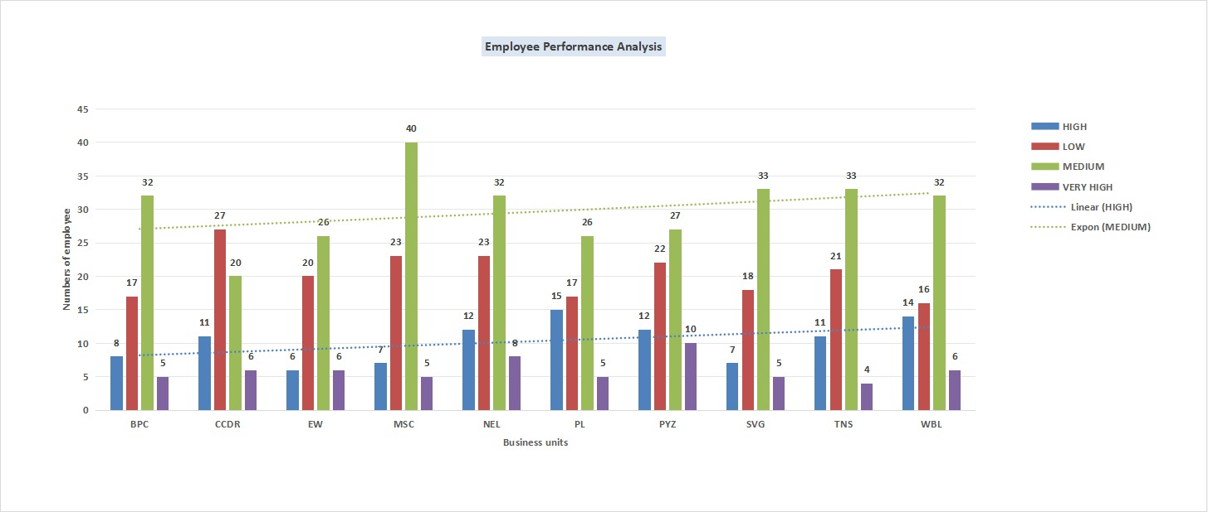
RESULTS
11

Slide 12
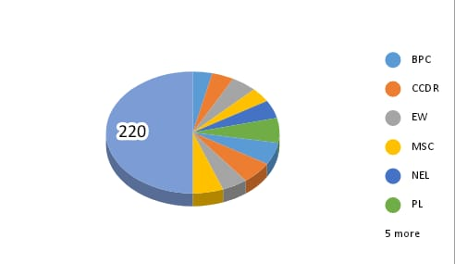
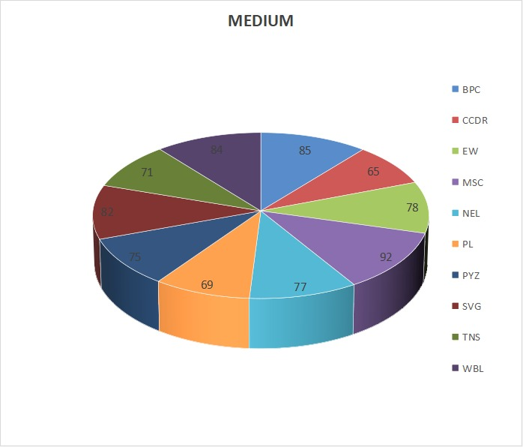
Results

Slide 13
conclusion
Conclusion:
Attendance and Performance Correlation:
1. The analysis indicates a [positive/negative/neutral] correlation between employee attendance and their performance. Employees with higher attendance tend to have [higher/lower] performance ratings.
Impact of Attendance on Productivity:
2. Consistent attendance appears to [positively/negatively] impact overall productivity, as employees who are regularly present can contribute more effectively to team goals and project timelines.

